Slide 1
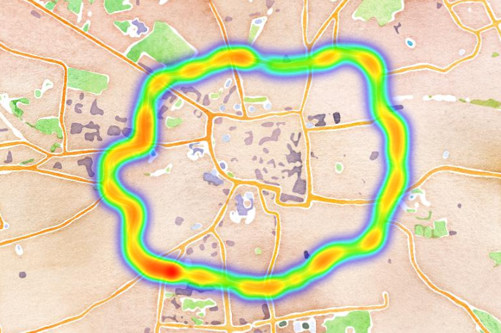
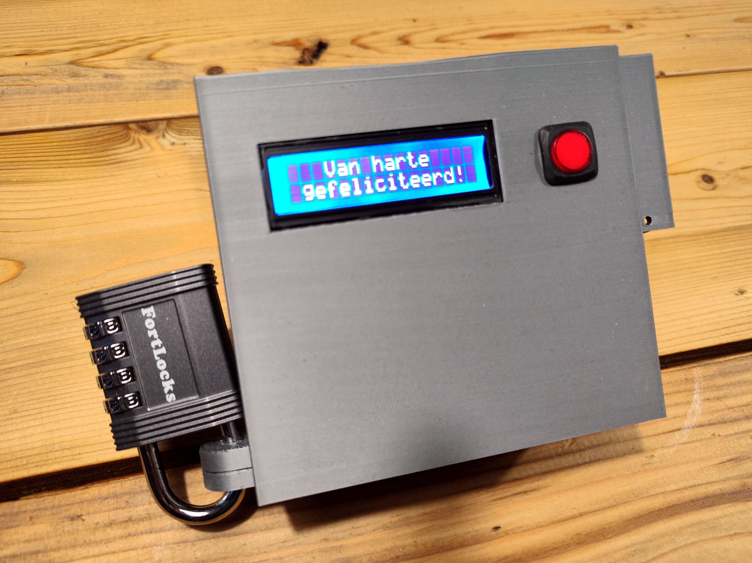

How to solve a mystery box

Slide 2

How to solve a mystery box
like a data scientist: get data, train ViT, minimize; and way too overkill
https://linkedin.com/in/dennisbakhuis

Slide 3
https://linkedin.com/in/dennisbakhuis

Slide 4
p1
G
p2
A = d1 - d2
d1
d2
B

Slide 5
p2
G
A = 0
d1 = d2
d2
p1
d1
B

Slide 6
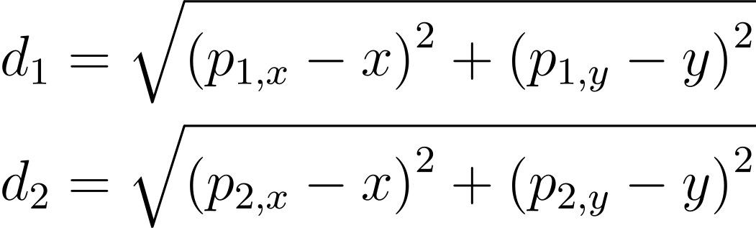

Slide 7
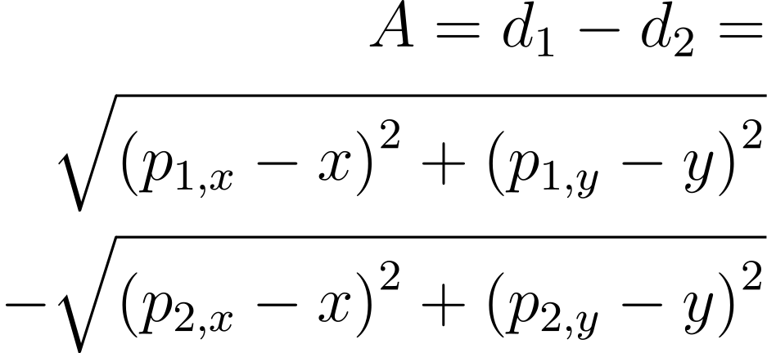

Slide 8
G
p2
c2
p1
c1
d2
d1
A = c1 - c2
B

Slide 9
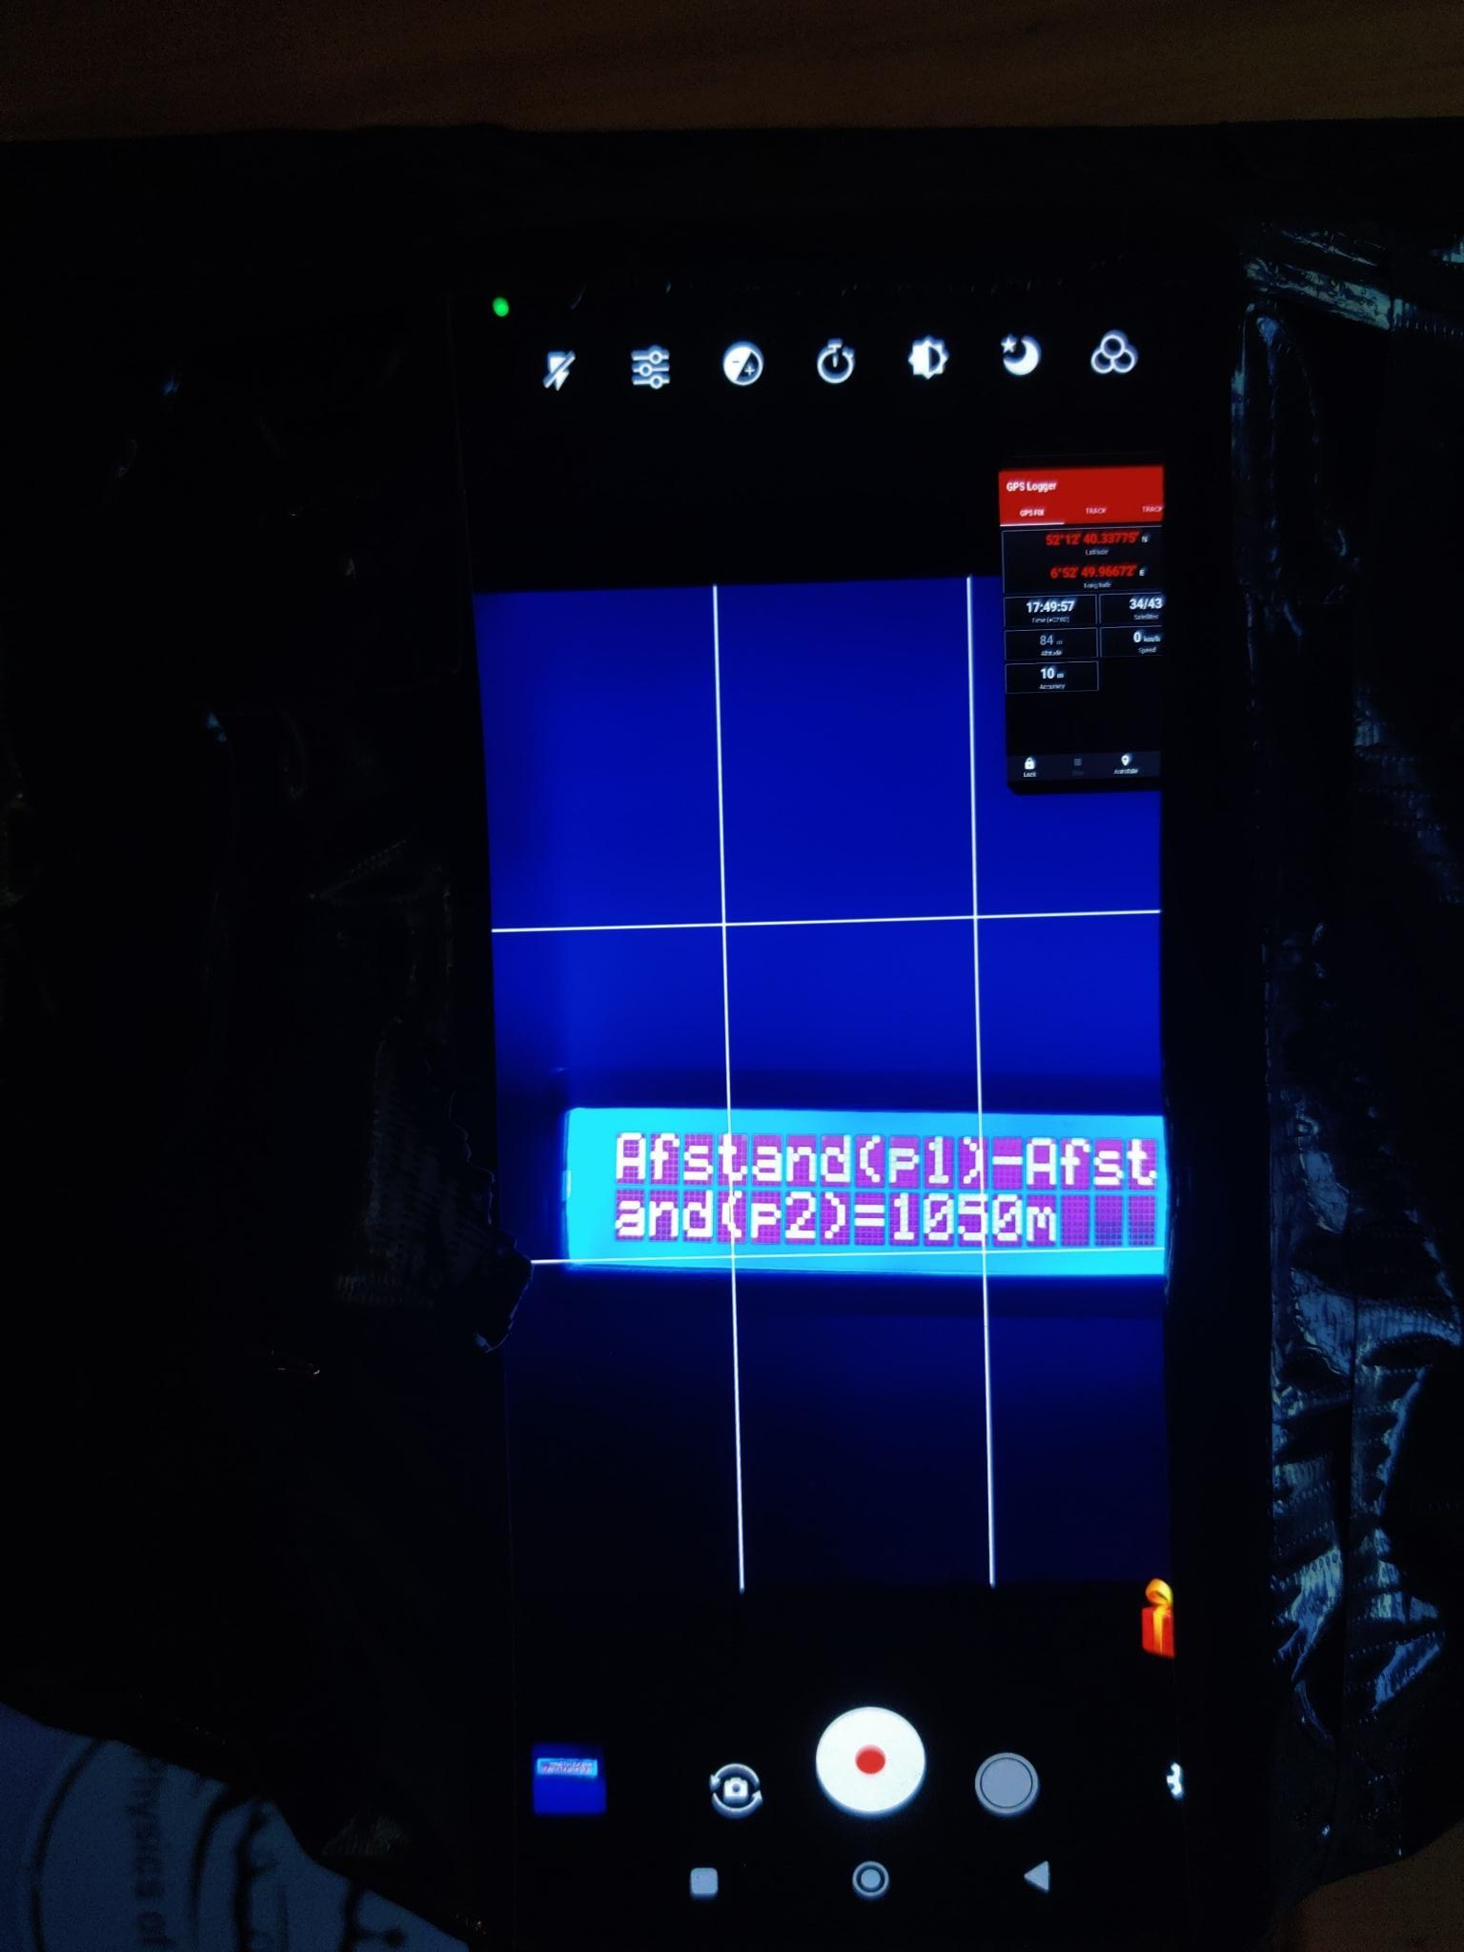
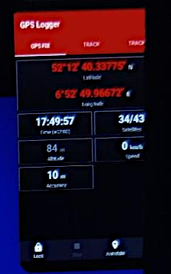

Slide 10
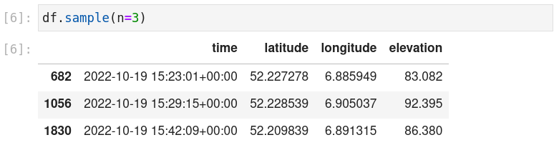

Slide 11
